Slide 1
Natural Language Processing (NLP) Capstone
Rich Fremgen
AUGUST 18th, 2022

Slide 2






What is Natural Language Processing (NLP)?
“ Natural language processing (NLP) is a branch of artificial intelligence that helps computers understand, interpret and manipulate human language. NLP draws from many disciplines, including computer science and computational linguistics, in its pursuit to fill the gap between human communication and computer understanding.”
- SAS Institute

Slide 3

NLP Project Outline
Workflow Idea: applying NLP to the investment process to quantify sentiment
Sentiment Analysis:
Develop a model to quantify the news's sentiment (and magnitude) around different companies of interest across the infrastructure/renewables/utility's universe
Explore differences across news source, sector, and how sentiment trend over time have changed
Compare sentiment trends to historical performance and trading volume
Reasoning:
Sentiment is one of the hardest factors to measure and even more difficult to identify turning points
Text data is incorporated in the investment process, but traditionally from a qualitative standpoint, what if we could apply NLP techniques to quantify how a company, sector or area of interest is perceived within the news?
NLP provides a platform to scale an analysis across many domains and over time

Slide 4
How to Extract News Articles at Scale? Use an API
Application Programming Interface (API)
Type of software interface (website) that allows programmatic access to data from a database or on a web server
Newscatcher API:
Aggregates both historical and current relevant news articles based on search
Easily accessible through the Python programming language
Newscatcher API Features
Date Range | January 2020 – Present
News Websites | 60,000
Daily Articles | 1.5 million
Output Data
Article Title | Author
News Source | Date
Topic | Full Article Content
Is Opinion? | Language
Applicability Score | Website Rank
URL | Country

Slide 5












News Sources Filter
Majestic Million:
Ranks the top million websites based on citations from other websites
Most ‘important’ sites on the web (SEO statistics)
Newscatcher API:
Filtered to only return articles from top 250 ranked websites

Slide 6





Sentiment Analysis Workflow: High Level
Get data
Analyze data
Store data
Present data
HIGH LEVEL
MySQL
API REQUEST
Return Data
Make Request

Slide 7
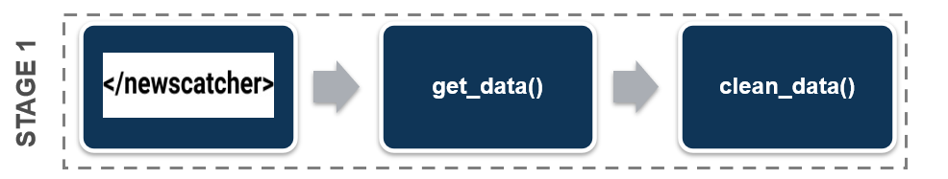
Sentiment Analysis Workflow: Python STAGE 1
Objective:
Extract queried data from Newscatcher API
Preliminary data cleaning
Features:
Optimized request calls from API
Minimizes delay time
Maximizes data consumption
Flexible search
Easily modify search term
Duplicate article removal
Fuzzy matching
Kansai
Kansai Electric
9503 JT
9503 JP
API Search Example

Slide 8
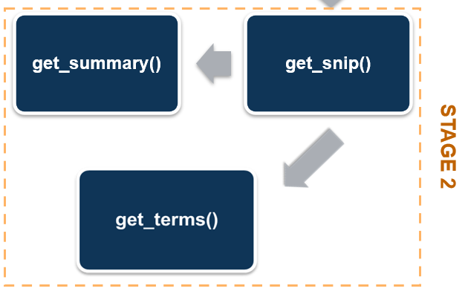
Sentiment Analysis Workflow: Python STAGE 2
Objective:
Take a long, multipage article and condense it down to just the ‘snippets’ of interest
Make the data conducive for integration into the Stage 3 language model
Features:
Snippet Extraction + Combine Snippets
Summarize Snippets (T5 Model)
Extract Key Words + Frequencies

Slide 9
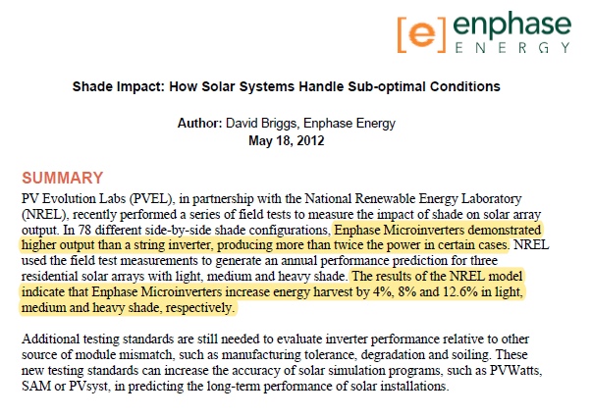
Python STAGE 2 – How Snippets Are Extracted
Snippet 1
Snippet 2
Article Example
Enphase microinverters demonstrated higher output than a string inverter, producing more than twice the power in certain case. The results of the NREL model indicate that Enphase Microinverters increase energy harvest by 4%, 8%, and 12.6% in light, medium and heavy shade, respectively.
Snippet 1
+
Snippet 2
=
Combined Snippets

Slide 10
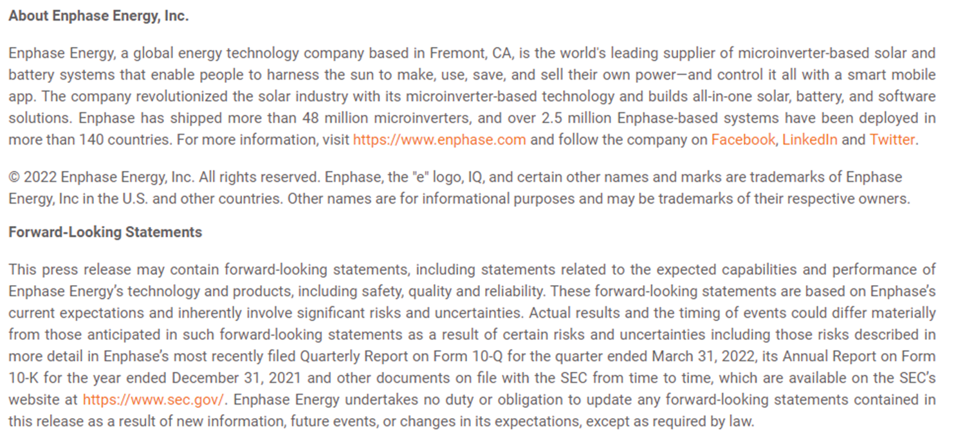
Python STAGE 2 – All Relevant Snippets Aren’t Useful
Boilerplate Text Problems:
Do not provide context to calculating the sentiment of the article
Tendency to drive sentiment scores towards Neutral
Drastically increase the size of the extracted snippet
Boilerplate Text Example

Slide 11
Python STAGE 2 – Summarizing Snippets with T5
Text-To-Text Transfer Transformer (T5)
Multi-Task Transformer model from Google
Trained with Masked Language Model (MLM): fill-in-the-blank task
Advantage: removes boilerplate text + reduces size of text
“China’s Huawei overtook Samsung Electronics as the world’s biggest seller of mobile phones in the second quarter of 2020, shipping 55.8 million devices compared to Samsung’s 53.7 million, according to data from research firm Canalys. While Huawei’s sales fell 5 per cent from the same quarter a year earlier, South Korea’s Samsung posted a bigger drop of 30 per cent, owing to disruption from the coronavirus in key markets such as Brazil, the United States and Europe, Canalys said. Huawei’s overseas shipments fell 27 per cent in Q2 from a year earlier, but the company increased its dominance of the China market which has been faster to recover from COVID-19 and where it now sells over 70 per cent of its phones. “Our business has demonstrated exceptional resilience in these difficult times,” a Huawei spokesman said. “Amidst a period of unprecedented global economic slowdown and challenges, we’re continued to grow and further our leadership position.” Nevertheless, Huawei’s position as number one seller may prove short-lived once other markets recover given it is mainly due to economic disruption, a senior Huawei employee with knowledge of the matter told Reuters. Apple is due to release its Q2 iPhone shipment data on Friday.”
FULL ARTICLE
SUMMARY
“Huawei overtakes Samsung as world’s biggest seller of mobile phones in second quarter of 2020. Company shipped 55.8 million devices compared to Samsung’s 53.7 million, Canalys says. Sales fell 5% from same quarter a year earlier, owing to disruption from coronavirus. But company increased its dominance of the China market which has been faster to recover from COVID-19.”

Slide 12
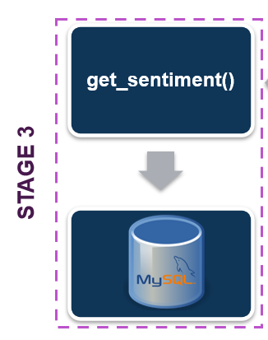
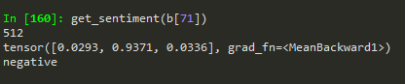
Sentiment Analysis Workflow: Python STAGE 3
Objective:
Generate sentiment scores for every ‘summarized’ article snippet
Output sentiment results to MySQL database
Features:
FinBERT Model
Python to MySQL Connection
Sentiment Score Output Example
Probability Vector
[Positive, Negative, Neutral]
Predicted Sentiment

Slide 13
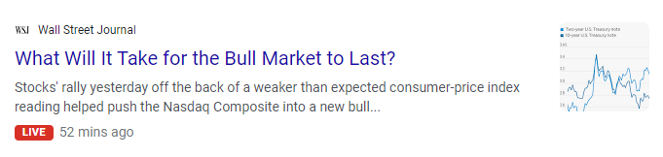



Python STAGE 3 - Why does domain language matter?
FINANCE
FESTIVAL
ANIMAL
SPORTS

Slide 14




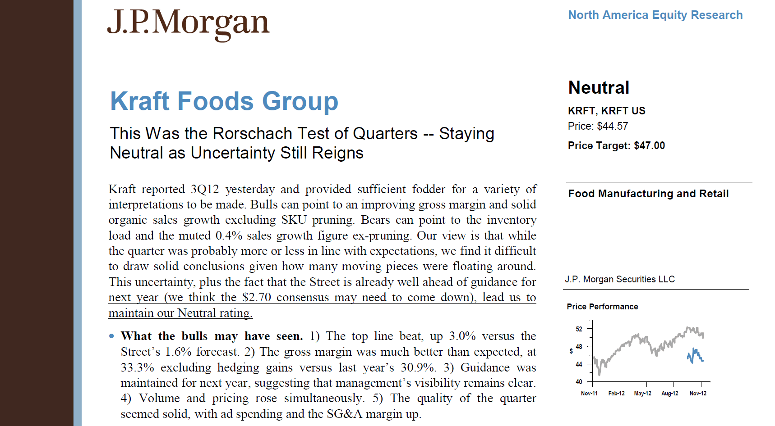

Python STAGE 3 - FinBERT
Bidirectional Encoder Representations from Transformers (BERT)
Developed in 2018 by researchers at Google AI Language
Swiss knife for common NLP tasks (sentiment analysis, question answering, etc.)
Trained on Wikipedia (2.5B words) + Google’s Book Corpus (800M words)
BERT for Financial Text Mining = FinBERT
Pre-Trained NLP model to analyze sentiment of financial text
Developed due to differences in vocabulary and expression between the financial corpus and general domain corpus
BERT
FinBERT

Slide 15


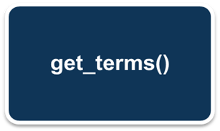

Sentiment Analysis Workflow
STAGE 1
.
get_data()
clean_data()
get_snip()
get_summary()
get_sentiment()
STAGE 3
STAGE 2

Slide 16
Tableau Demonstration

Slide 17
Reference Slides

Slide 18
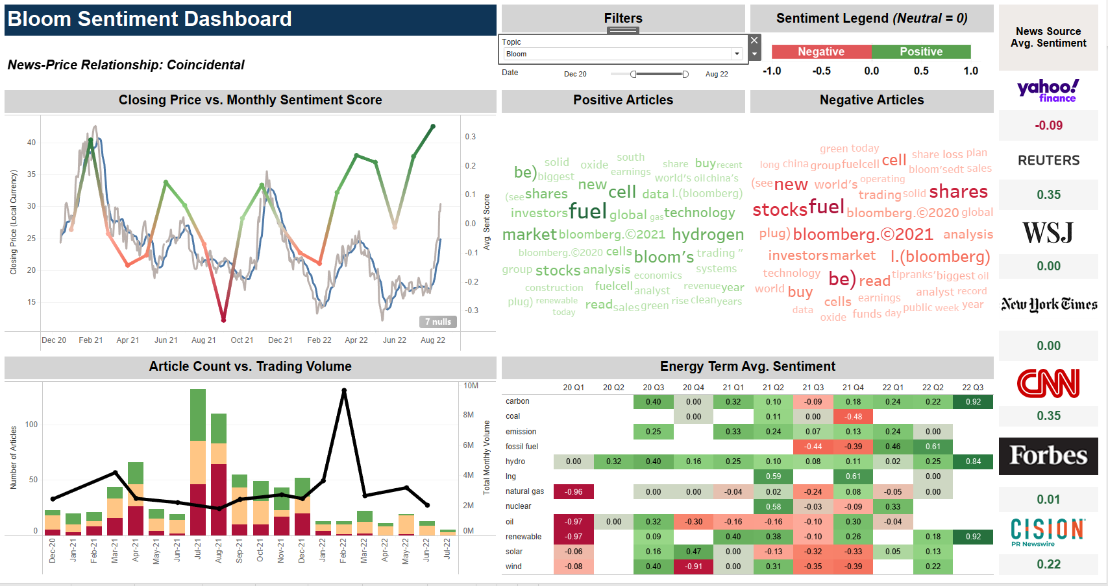
Bloom Energy

Slide 19
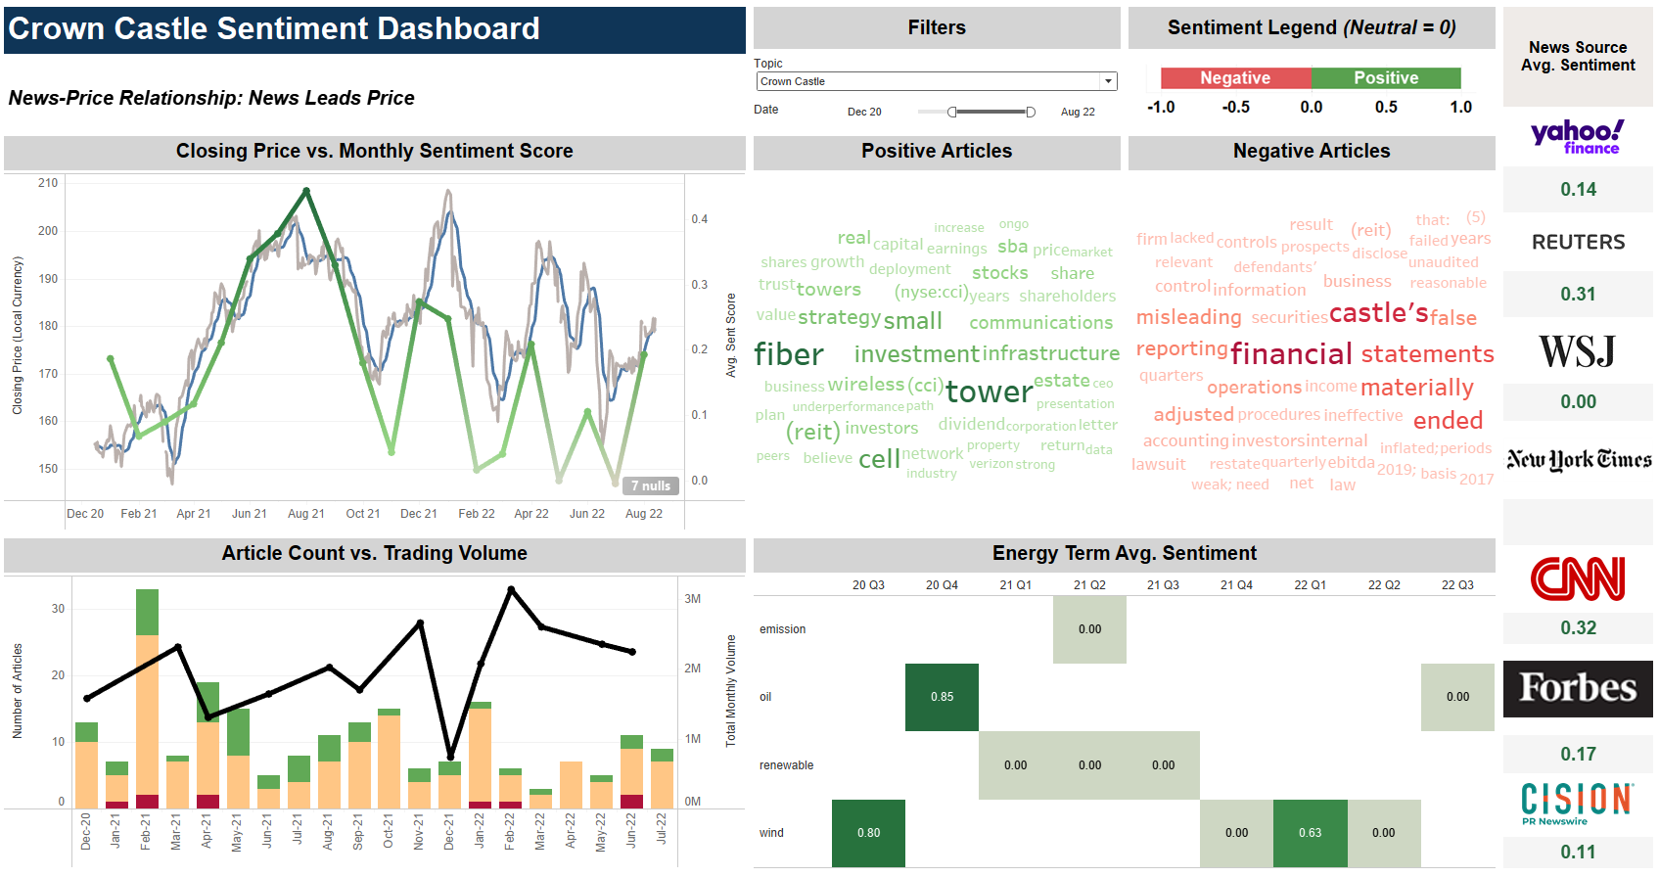
Crown Castle

Slide 20
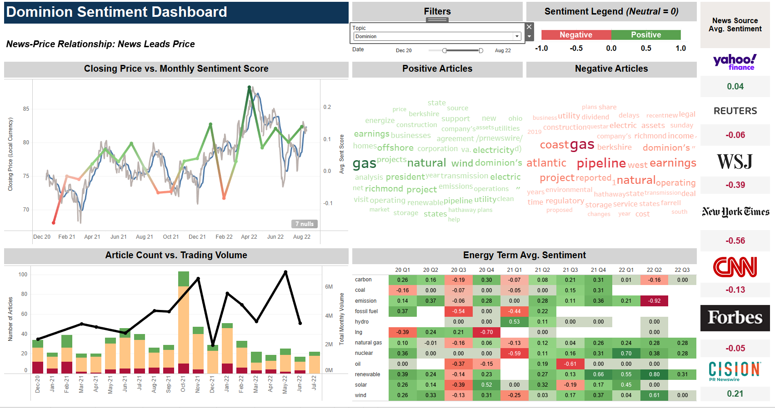
Dominion Energy

Slide 21
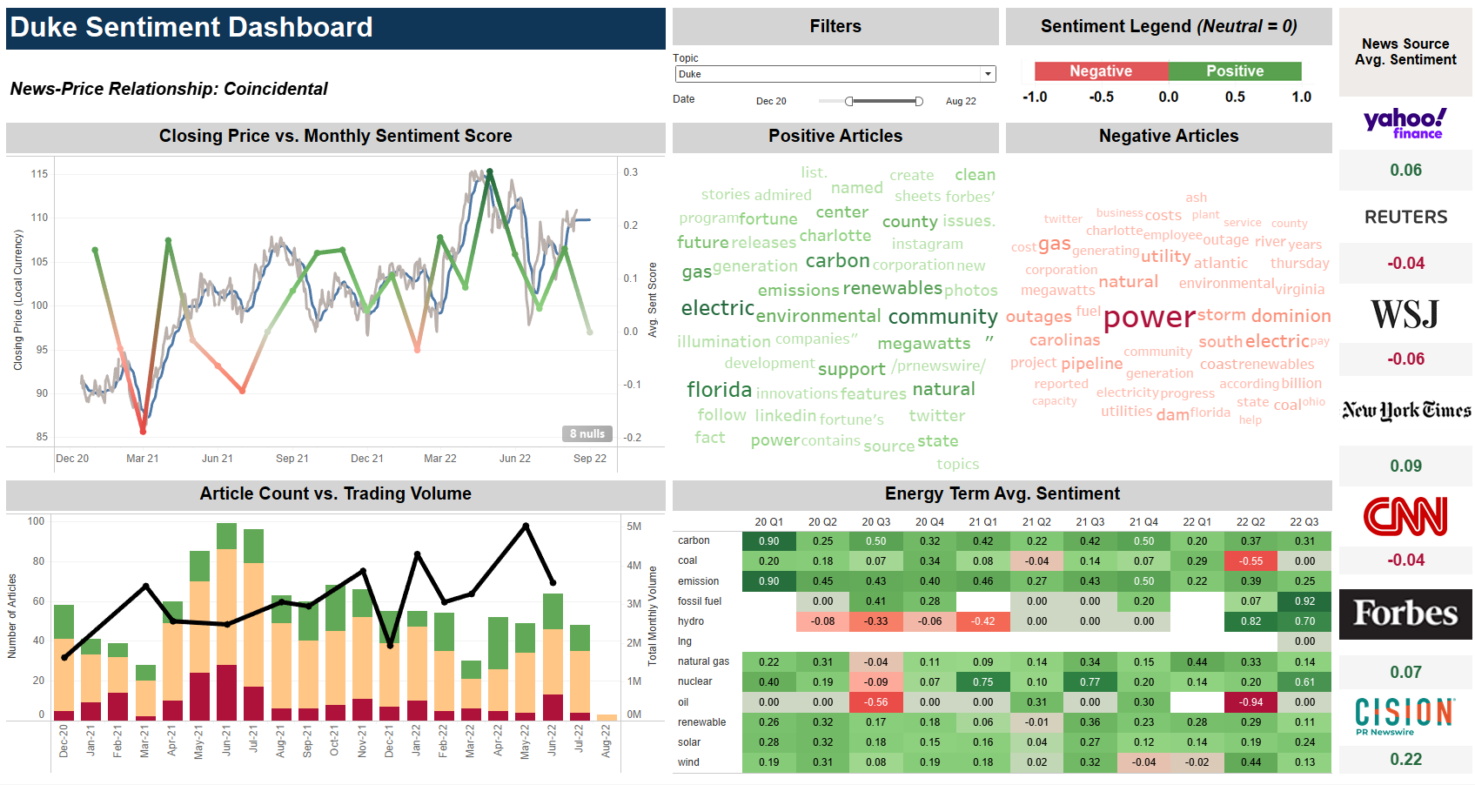
Duke Energy

Slide 22
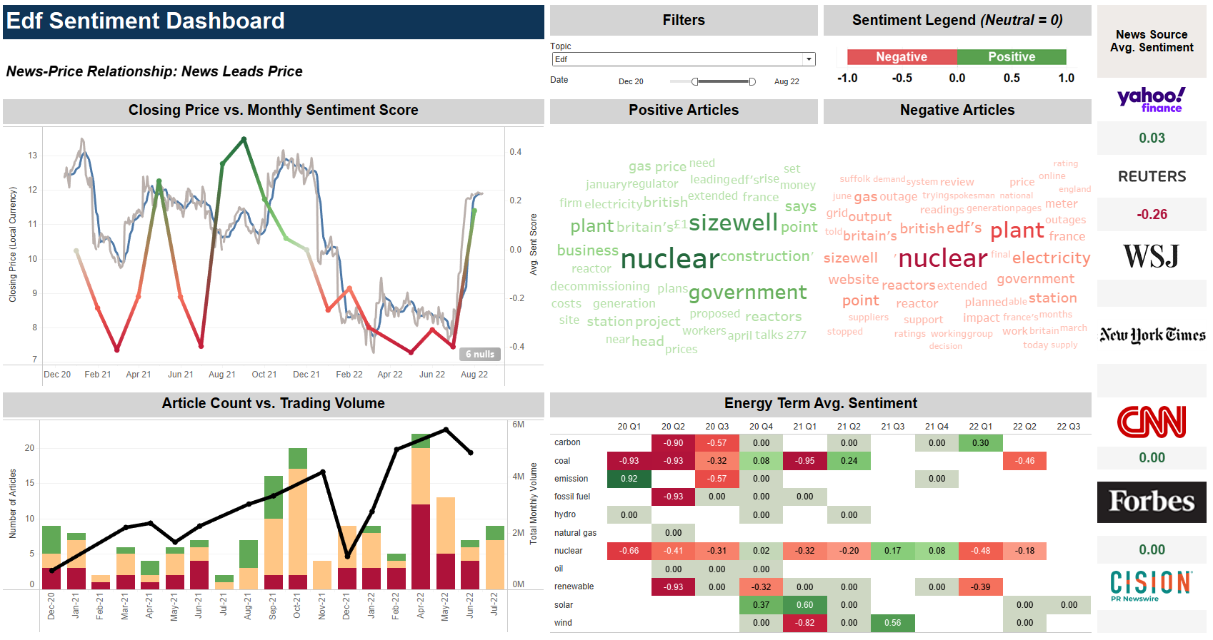
EDF

Slide 23
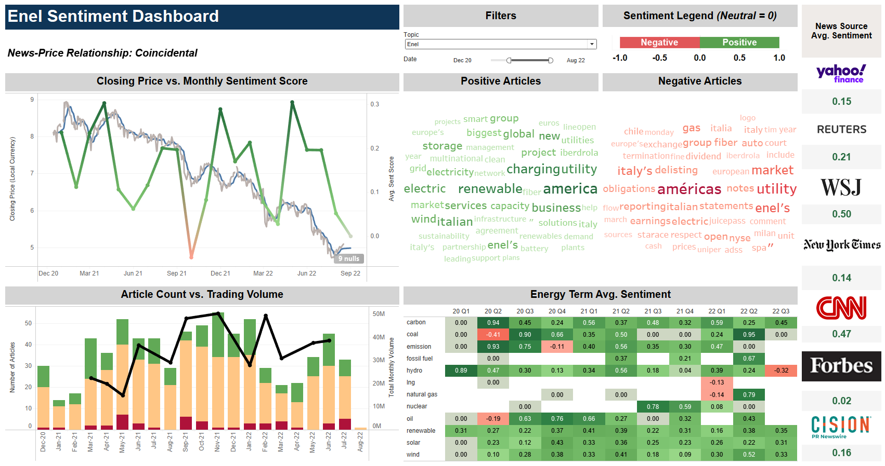
Enel

Slide 24
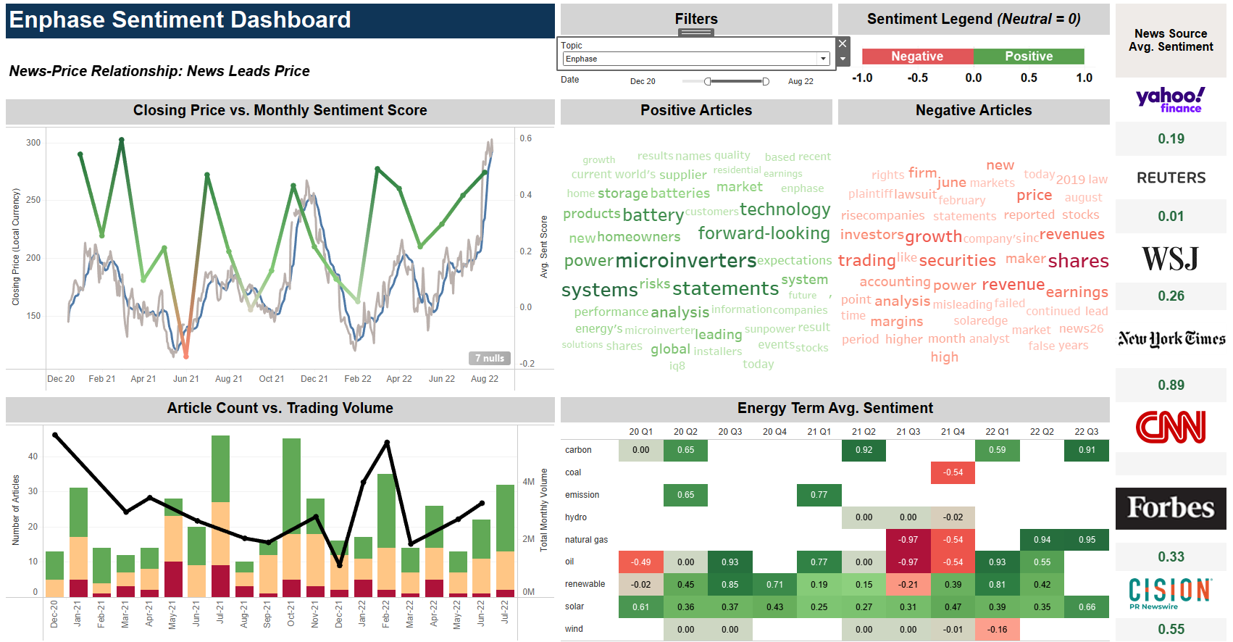
Enphase Energy

Slide 25
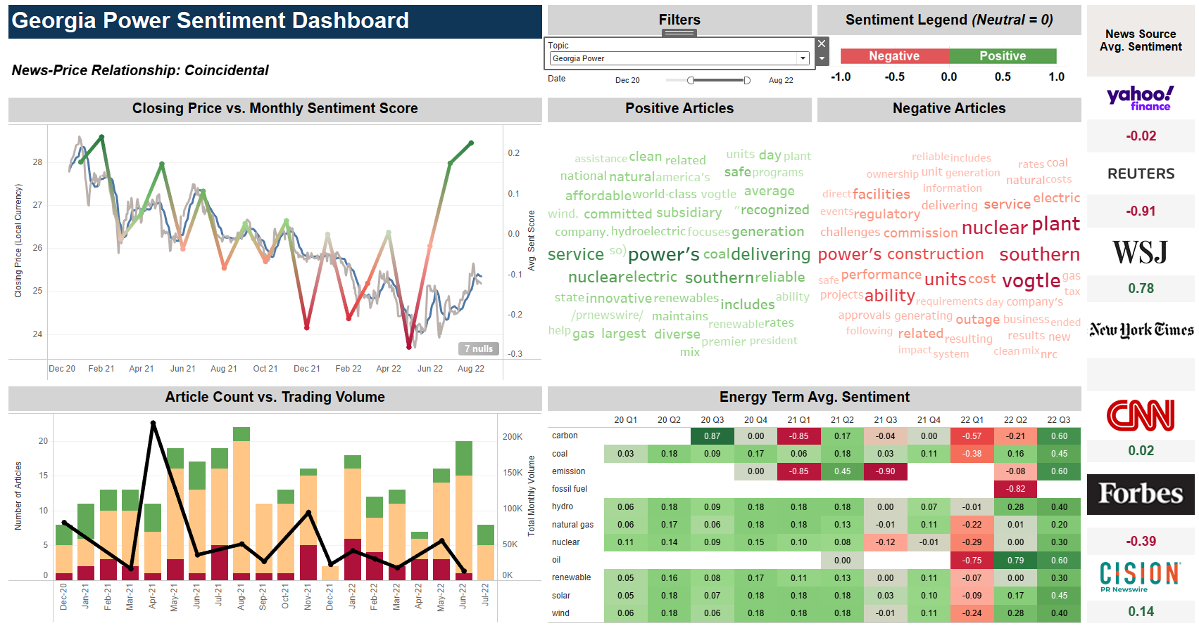
Georgia Power

Slide 26
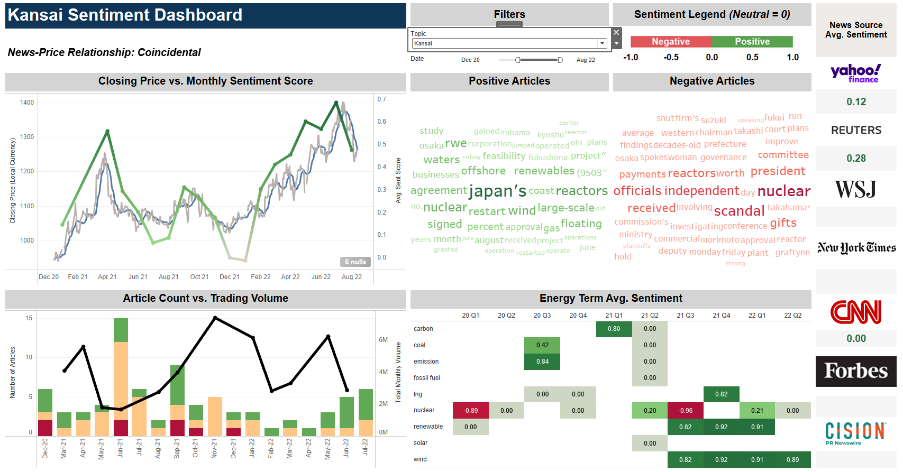
Kansai Electric (KEPCO)

Slide 27
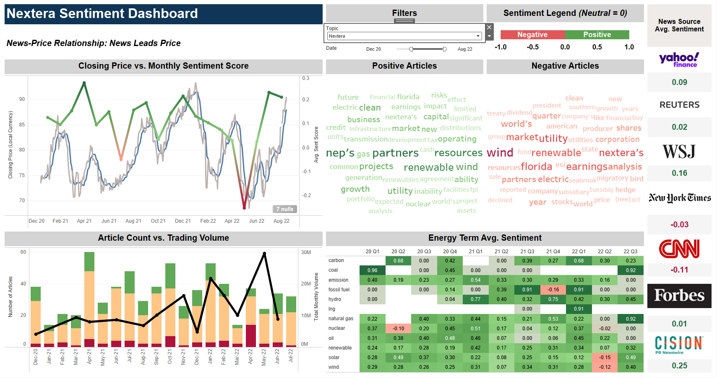
NextEra

Slide 28
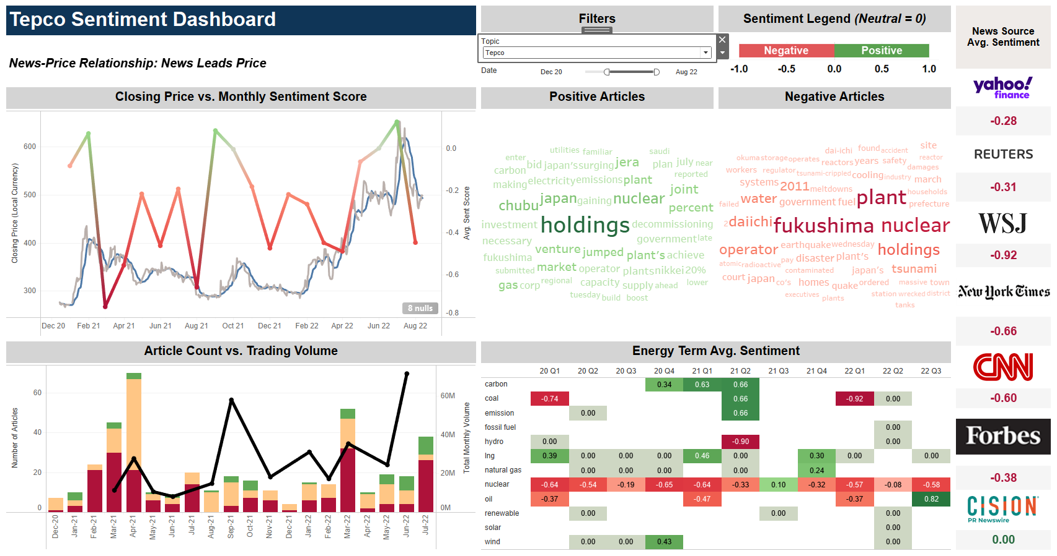
TEPCO

Slide 29
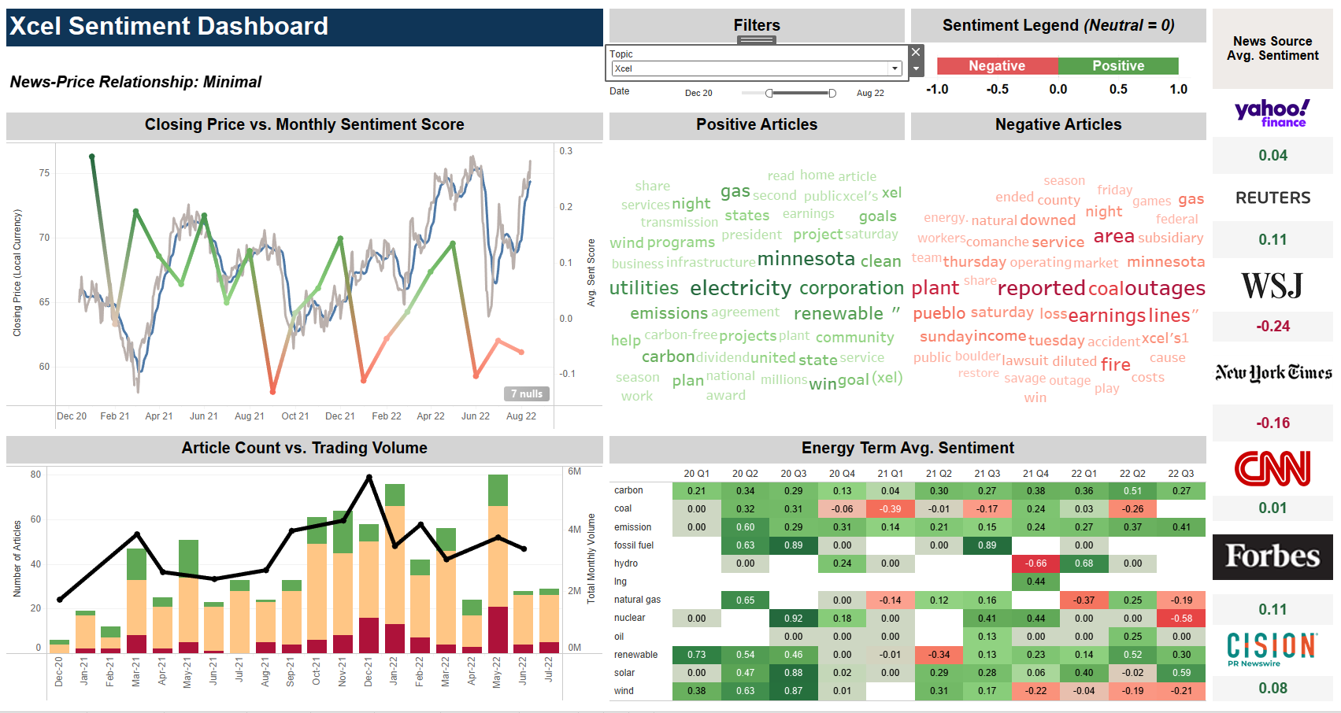
Xcel Energy

